Slide 1
Wasps!

Slide 2
Wasps: 9 common families in Kenya
Siricidae | She
Vespidae | Very
Sphecidae | Sophisticatedly
Crabronidae | Carries
Ampulicidae | A
Pompilidae | Purple
Mutillidae | Megaphone
Ichneumonidae | In
Braconidae | Business

Slide 3
Siricidae: horntails or wood wasp
Strong, projecting spike on last tergite of abdomen, hence its name
Long posteriorly projecting ovipositor
Typically brown/blue/black with yellow parts
Can be up to 5cm long

Slide 4
Siricidae: horntails or wood wasp
tail
ovipositor

Slide 5
Vespidae: yellow jackets, hornets, paper wasps etc
At rest, fore wings fold in half longitudinally
First discoidal cell of forewing greater than half the wing length
Inner margin of eye usually notched
Pronotum extend back to the tegulae, appearing V-shaped in lateral view and horseshoe-shaped from above

Slide 6
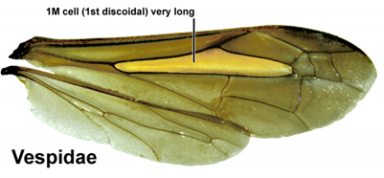
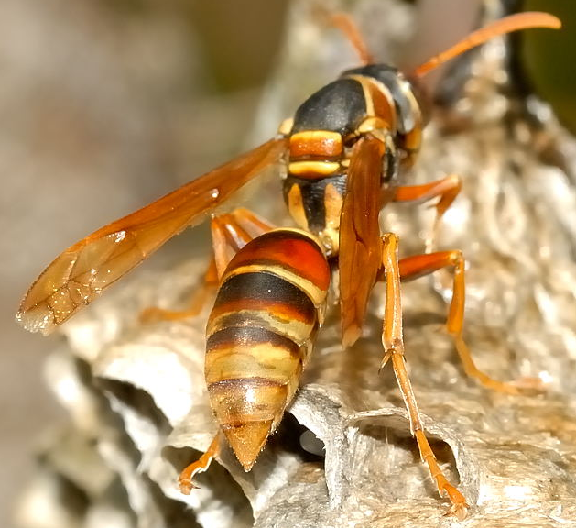
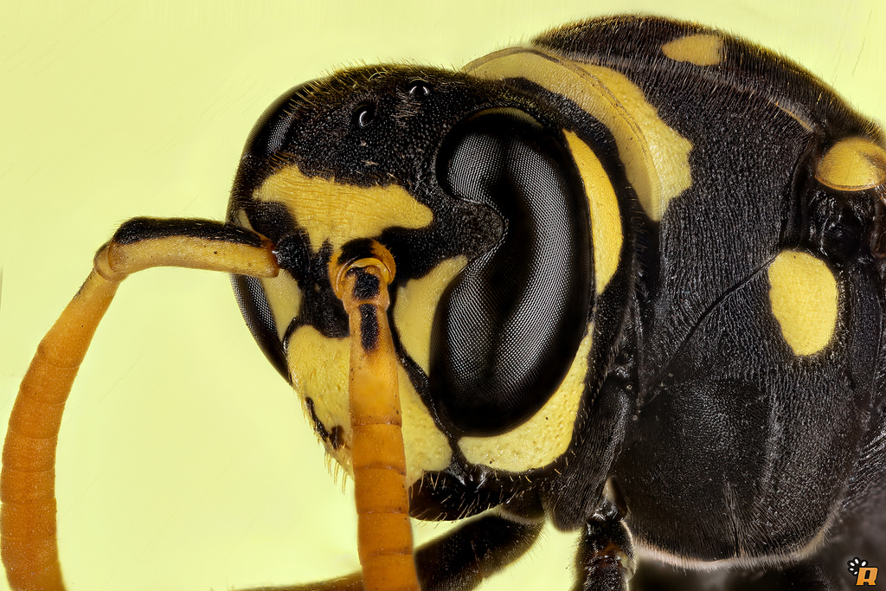
Vespidae

Slide 7
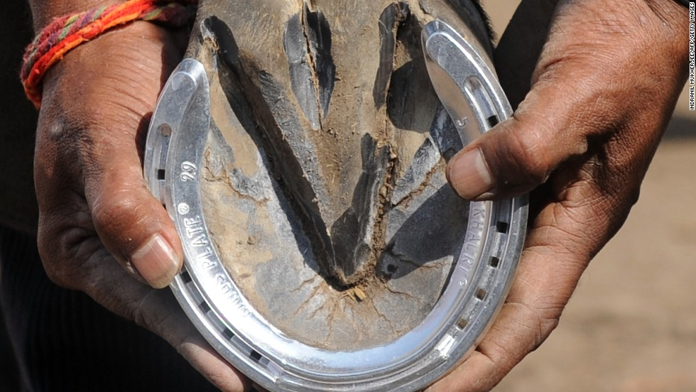
Vespidae: V (lateral) or horseshoe (dorsal)-shaped pronotum extend to tegulae

Slide 8
Sphecidae: thread-waisted wasps
Abdomen long and stalked, giving the body a "thread-waisted" appearance
Middle tibiae with two apical spurs
Black (sometimes tinged with metallic blue or green), black and red, yellow and black, or white and black
10-30mm

Slide 9
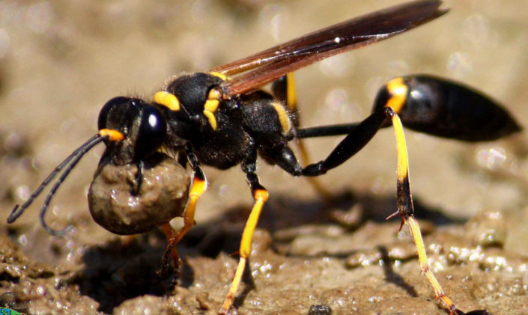
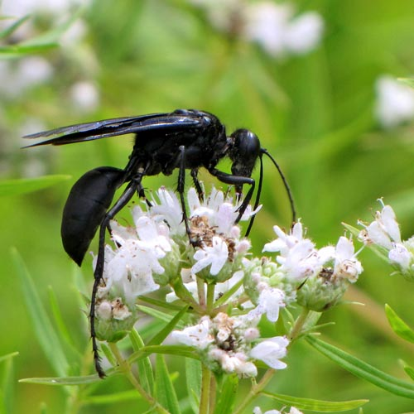
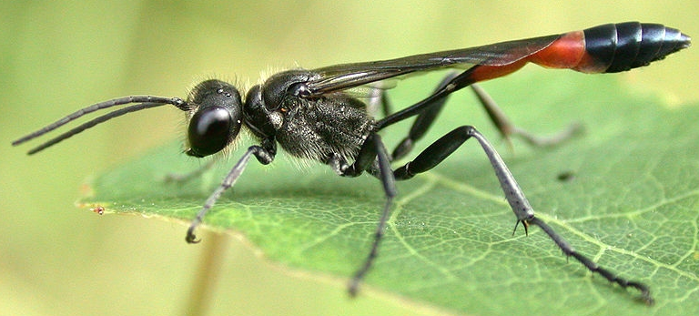
Sphecidae

Slide 10
Crabronidae: recently separated from sphecidae
Identifying features still in the works
At distinguishing features available at subfamily/tribe level and most authorities propose reclassifying these as families

Slide 11
Ampulicidae: cockroach wasps
Tend to have elongated jaws
Pronounced neck-like constrictions behind the head
Deep grooves on the thorax
Many are ant-like in appearance, though some are brilliant metallic blue or green.

Slide 12
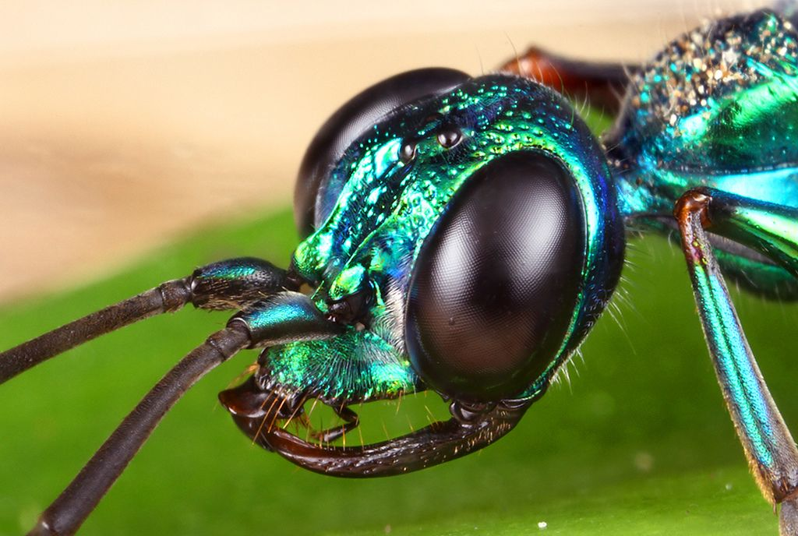
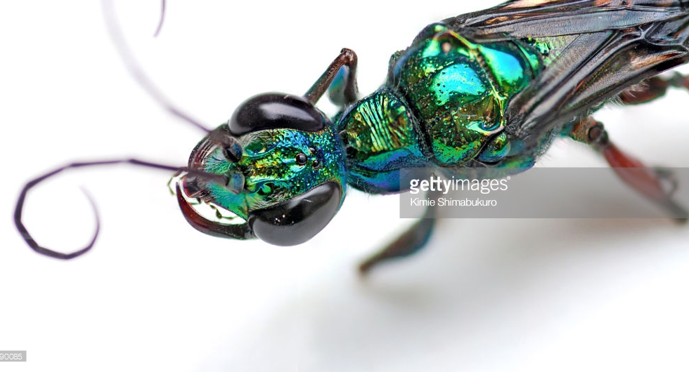
Ampulicidae
“Neck”

Slide 13
Pompilidae: spider wasps
Dark colored with smoky/yellowish wings (few bright color)
Slender with long and spiny legs, hind femora typically extend beyond tip of abdomen.
Two prominent spines on hind leg tibiae
Short 1st discoidal cell in forewing
Like the Vespidae, the pronotum extend back to the tegulae

Slide 14
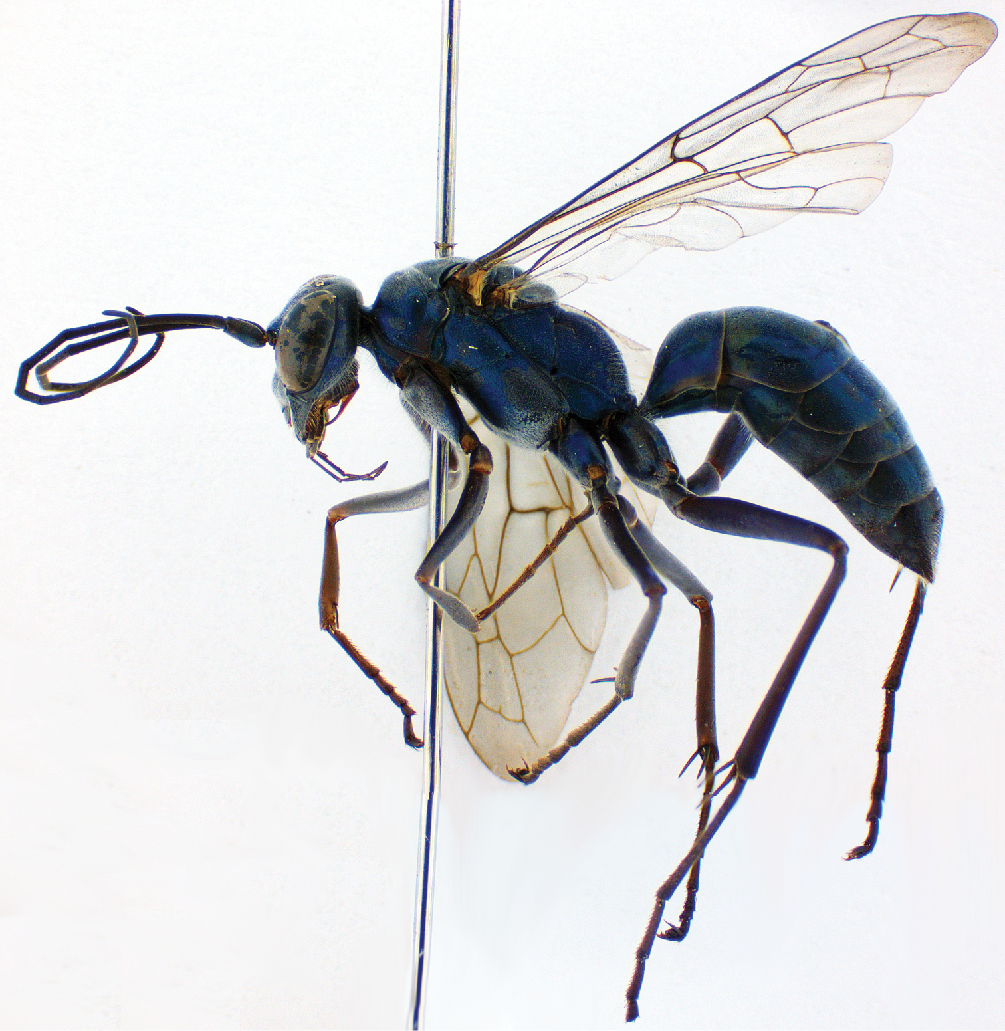
Pompilidae

Slide 15
Mutillidae: velvet ants
♀s lack lack wings, ♂s are winged
Coarse setae (hair) that cover most of their body, making them resemble hairy ants
‘hair’ usually bright scarlet or orange, may be black/white/silver/gold
Do not have ‘elbow’ antennae and no ‘hump’ on the waist
Tough exoskeleton

Slide 16
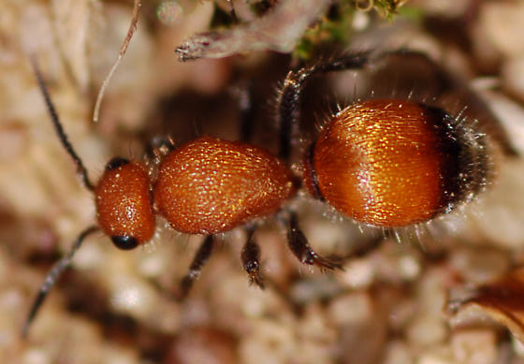
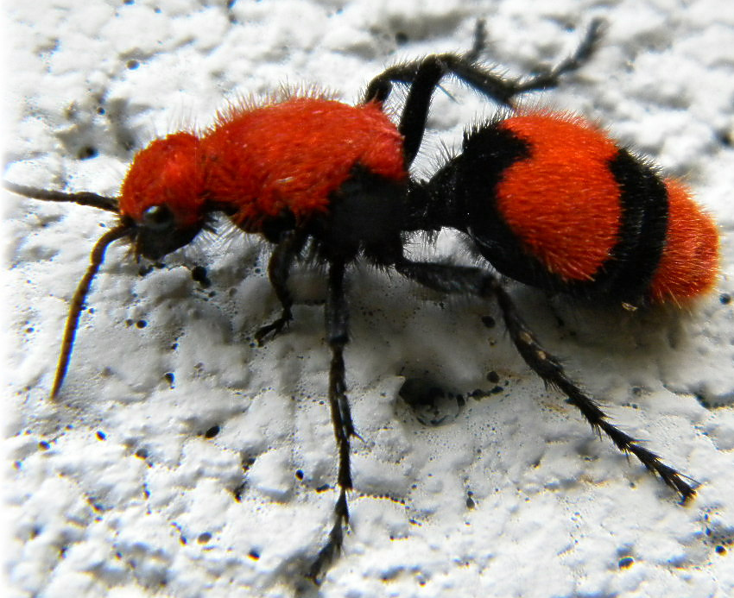
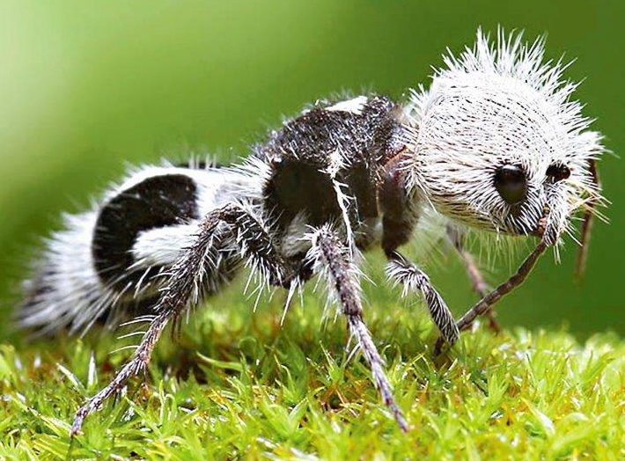
Mutillidae: velvet ants

Slide 17
Ichneumonidae
Slender; vary in size and color
Antennae with ≥16 segments and usually at least half as long as body.
Many are uniformly colored, from yellowish to black; others brightly patterned with black and brown or black and yellow
Many have middle segments of antennae yellowish or whitish.
Many have long ovipositors, often longer than the body.
Slender, wasplike. Two recurrent veins
Forewing venation form "horse head" shape

Slide 18
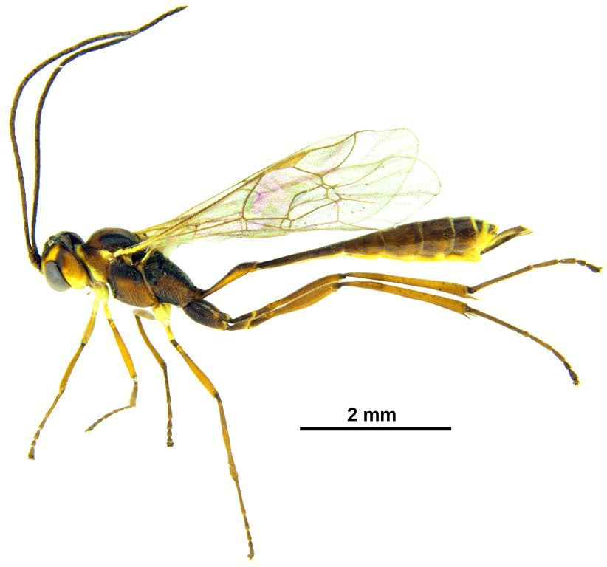
Ichneumonidae
“Horse head”
Antennae at least ½ body length

Slide 19
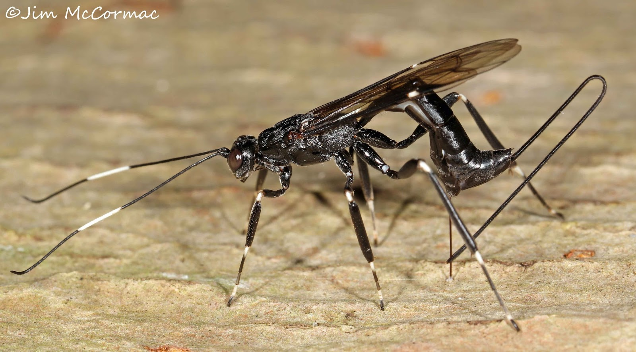
Ovipositor
Light middle antennae segment

Slide 20
Braconidae
Antennae ≥ 16 segments
Hind trochanters 2-segmented
Female ovipositor length varies widely, from very long to short
Often black-brown (sometimes with reddish markings), though some species exhibit striking coloration and patterns

Slide 21
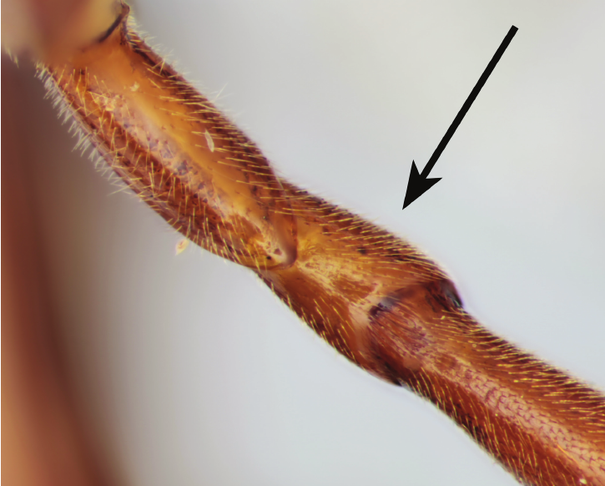
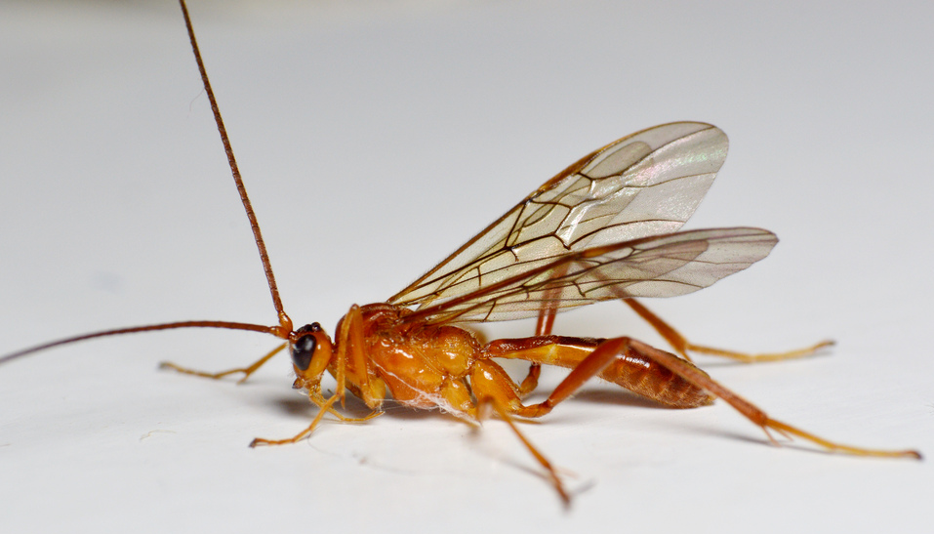
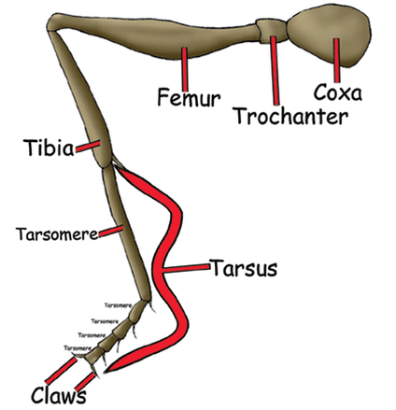
Braconidae

Slide 22
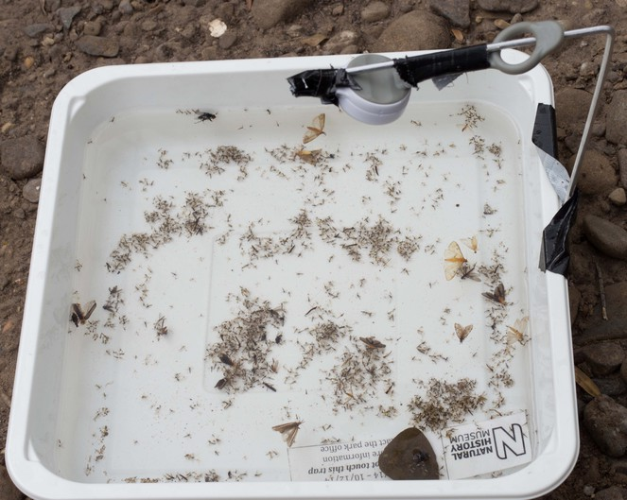
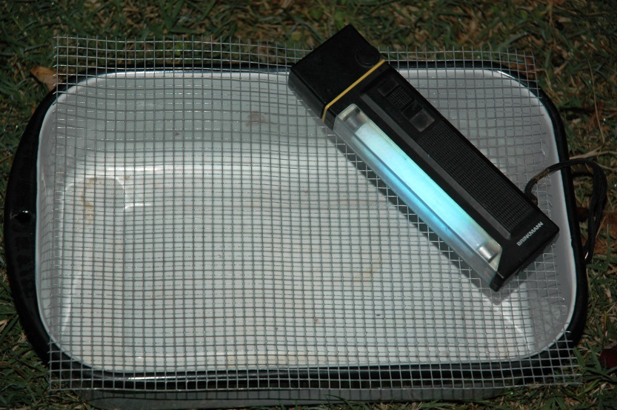
Tonight, we need to try the (UV) light+pan traps!

Slide 23
Friday!

Slide 24
Plan #1
Set up experiments to test if NTOs can assess contents of ATSBs: malaise + rearing chamber/cage with ATSB?

Slide 25
Plan #2
Sort samples collected from recently completed field collections into insect orders
For each collection method, calculate the relative abundance of each identified insect order – group results by location
If you’re feeling ambitious, perform statistical analysis to determine any differences in R/A of insect orders between methods and locations

