Slide 1
Orthoptera vs Homoptera (Hemiptera)

Slide 2
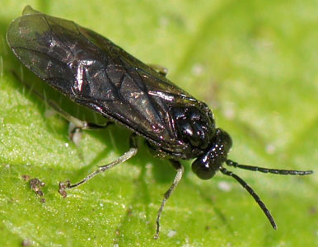
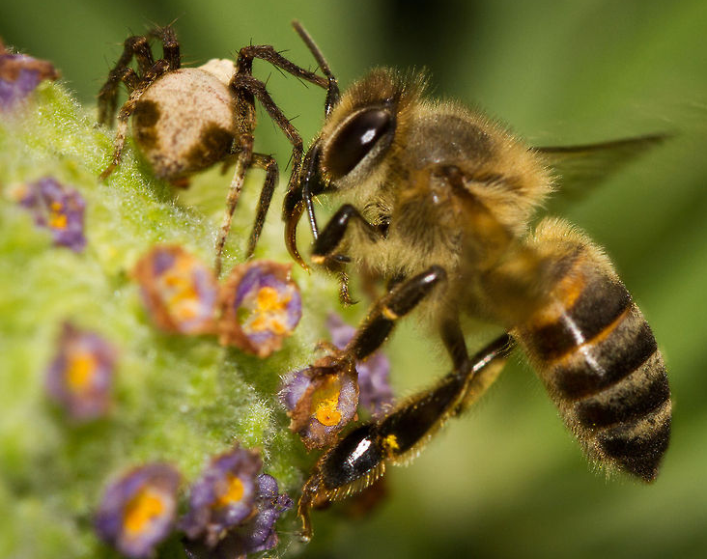
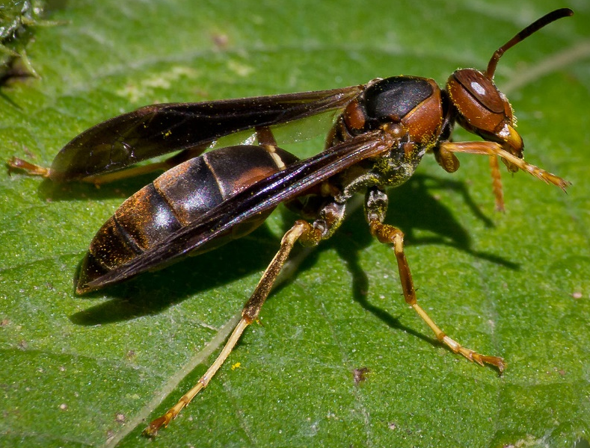
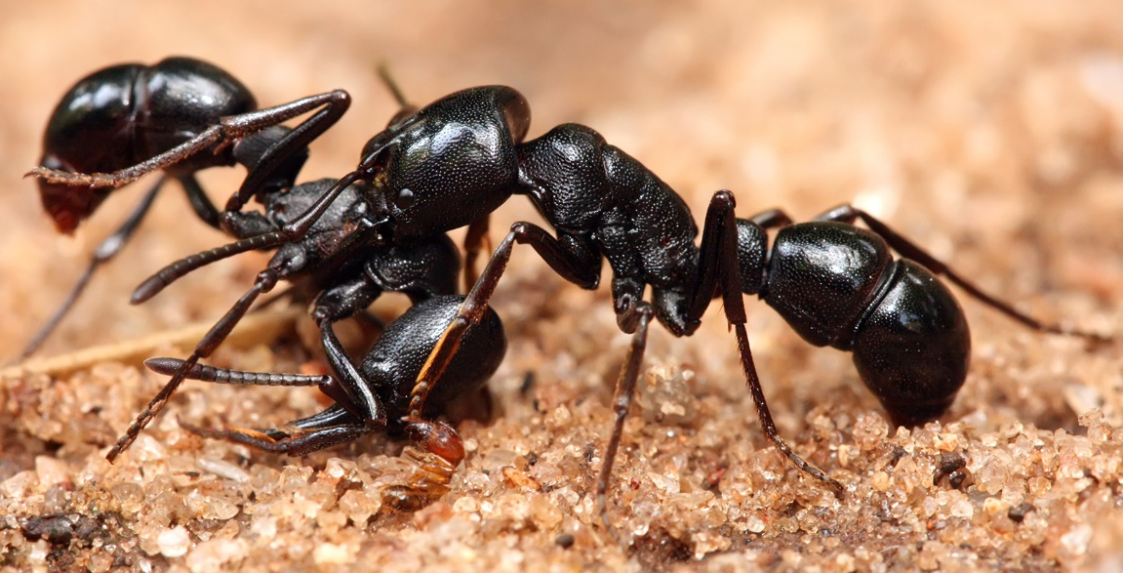
Hymenopterans: 14 common families in Kenya
sawfly
ant
bee
wasp
Notes:
Hymenopterans are the bees, wasps, ants and sawflies
14 common hymenopteran families in kenya which can be categorized into four groups: wasps, bees, sawflies and ants
narrow waist present in bees, wasps and ants (apocrita) but absent in sawflies (symphyta)
to the naked eyes, Bees are very hairy, while the others are bald
Within the apocrita, the bees are easily distinguishable because of their hairiness
Ants can be differentiated from wasps by their size; ants are usually smaller, and the shape of their antennae (elbow-shaped in ants)

Slide 3
Formicidae: all ants belong to this family!
Elbowed antennae
Small-medium size
Red/brown/black
Petiole: one/two/hard to see
Social – keys are typically for the workers
Notes:
They are different from termites, which belong to the order isopteran and can be distinguished from wasps by the presence of petiole
This is formed by a constriction between the second and third segment of the abdomen – remember that the first segment of the abdomen fuses with the thorax to form the mesonotum

Slide 4
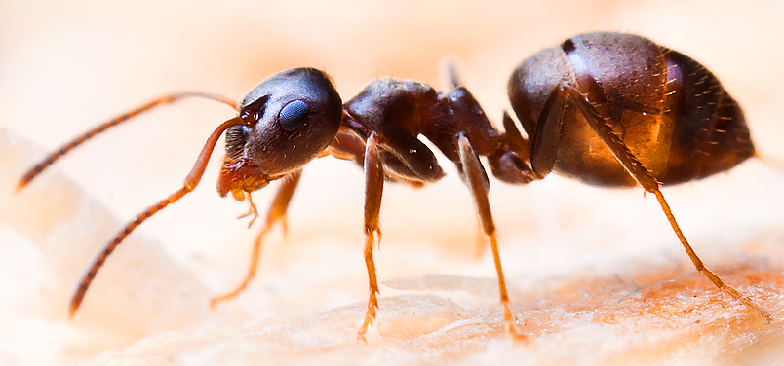
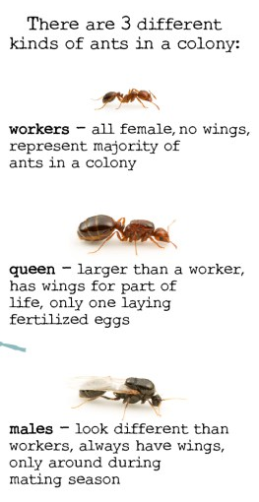
Formicidae: note color, size and petiole
Notes:
They are different from termites, which belong to the order isopteran and can be distinguished from wasps by the presence of petiole
This is formed by a constriction between the second and third segment of the abdomen – remember that the first segment of the abdomen fuses with the thorax to form the mesonotum

Slide 5
Tenthredinidae: commonest sawfly family
No easily seen diagnostic features, but, they typically possess;
Saw-like ovipositor
5 – 9 antennal flagellomeres
Clear separation of the first abdominal tergum from the metapleuron
3-20 mm long
No “narrow-waist“; no petiole
Often somewhat dorsoventrally flattened

Slide 6
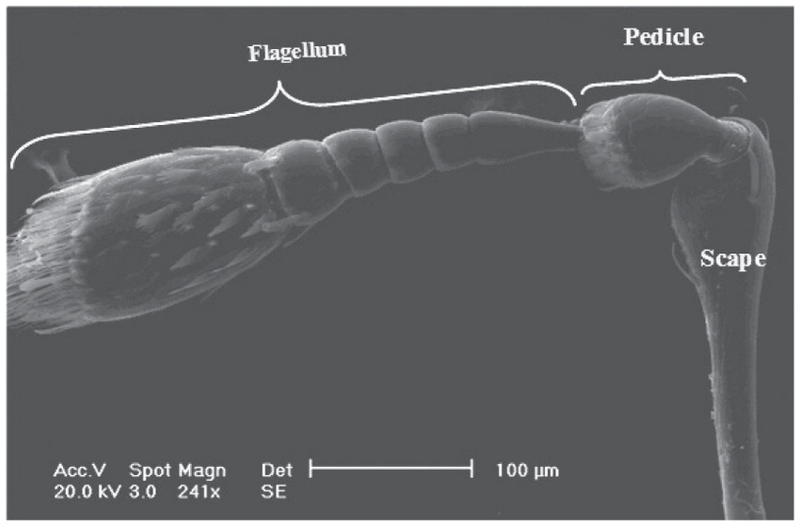
Antenna

Slide 7
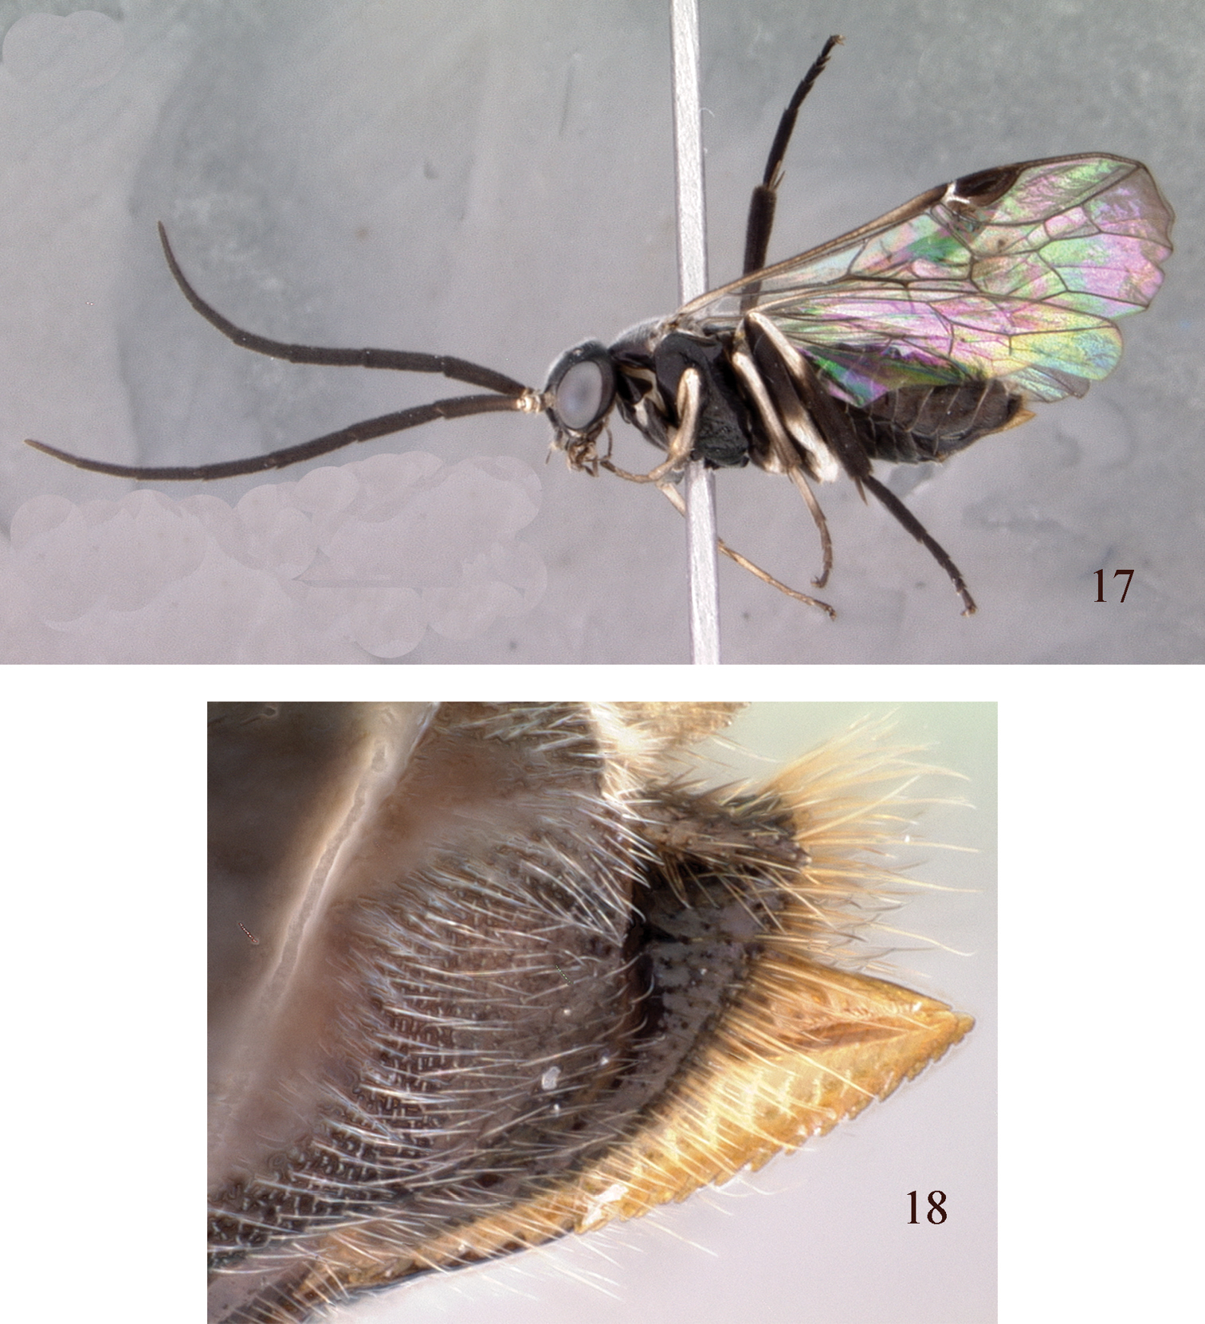
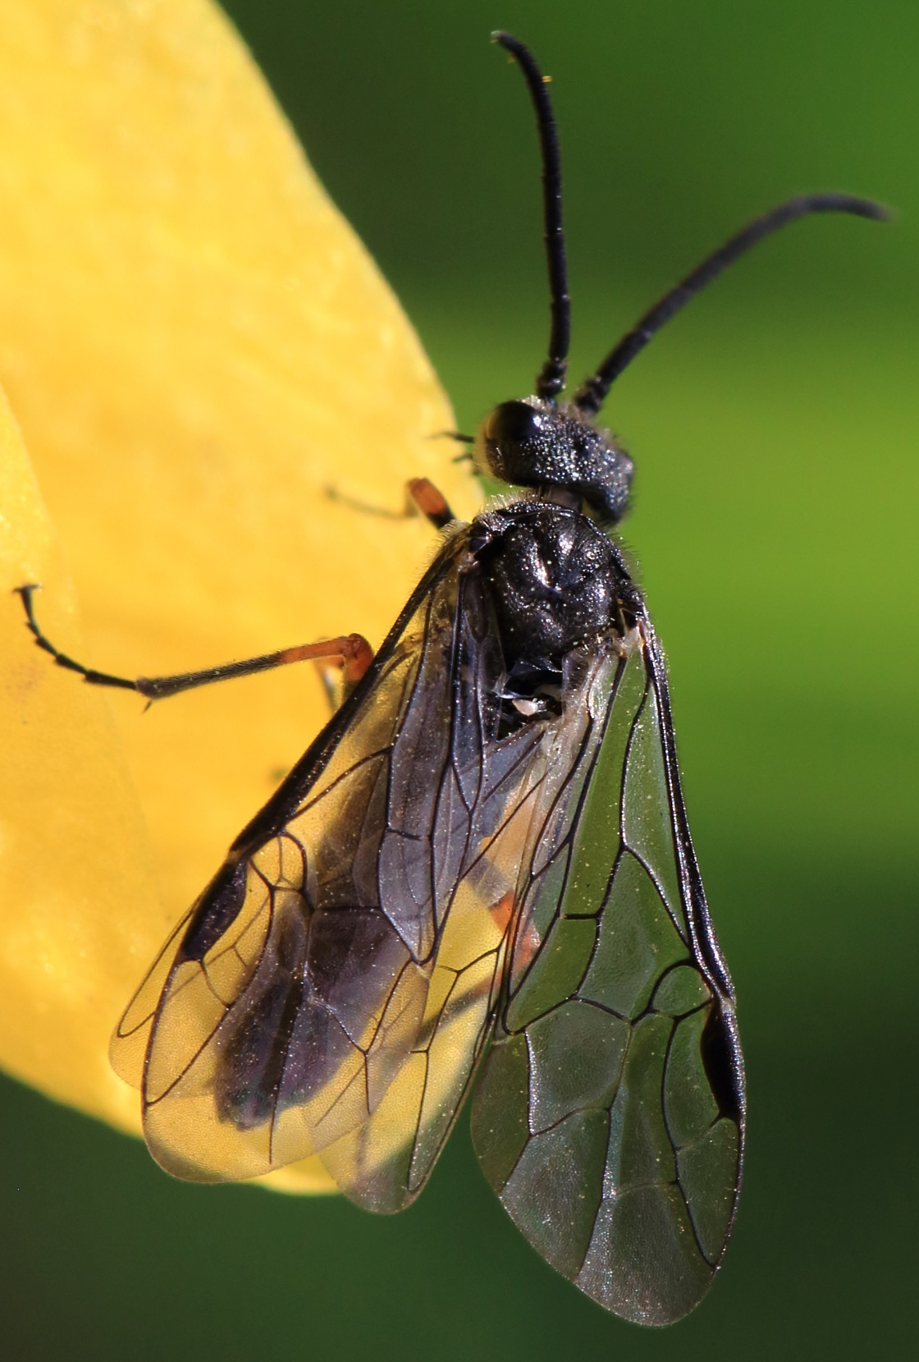
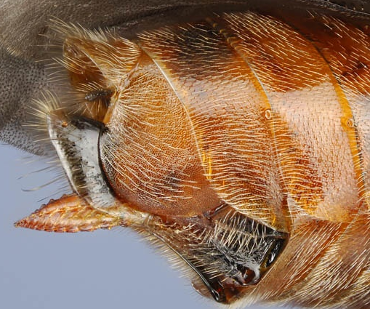


Slide 8
Bees: three major families in Kenya
Megachilidae (leaf cutting bees)
Apidae (honeybees, bumblebees and digger bees)
Halictidae (sweat bees)

Slide 9
Antenna
How can you tell a male from a female bee?
Answer: no. of flagellomere! 10 in females, 11 in males
Also, the presence of pollen collecting structures

Slide 10
Megachilidae: leafcutting bees
Moderately-sized ~5 mm – 24 mm
Stout-bodied
Black bees
Body hairs plumose – recall a ♂ mosquito’s antennae?
♀s, except the parasitic Coelioxys, possess scopa (for carrying pollen) on the underside of the abdomen rather than on the hind legs like other bees

Slide 11
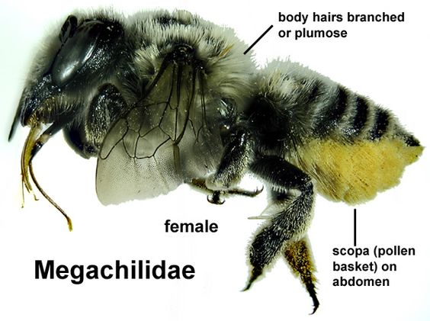
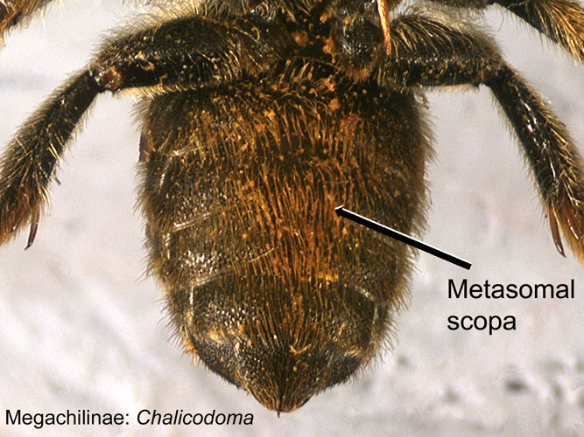
Megachilidae: leafcutting bees

Slide 12
Apidae: honey/bumble/digger bees
Usually black and yellow
Covered in abundant plumose hair
First segment of hind tarsi enlarged and flattened; usually bearing a “pollen basket” aka corbicular

Slide 13
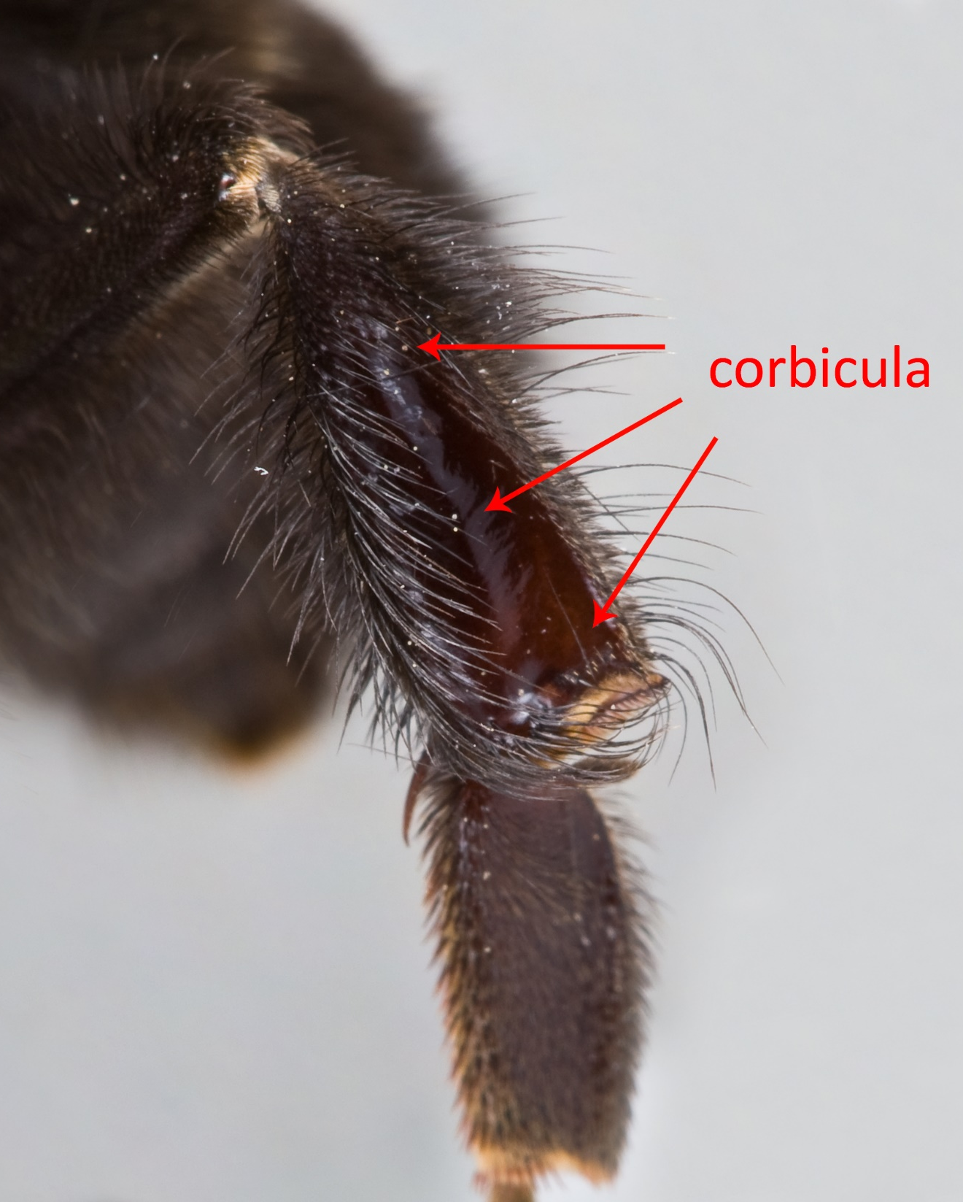
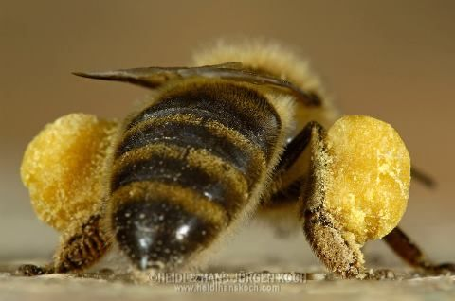
Corbicula: polished cavity surrounded by fringe hairs used in carrying pollen

Slide 14
Halictidae
Black/brownish/metallic (blue, green or purple)
4-10 mm (smallish)
Mostly slender (a few are robust)
♀s carry pollen on tibia and femur of hind legs
Strongly curved basal vein in wing

Slide 15
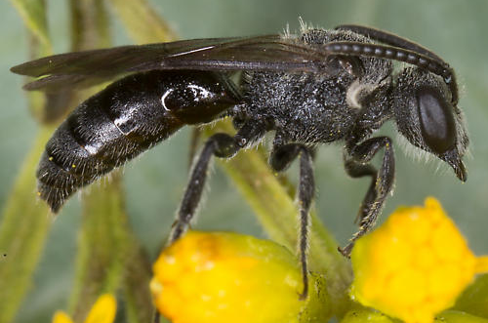
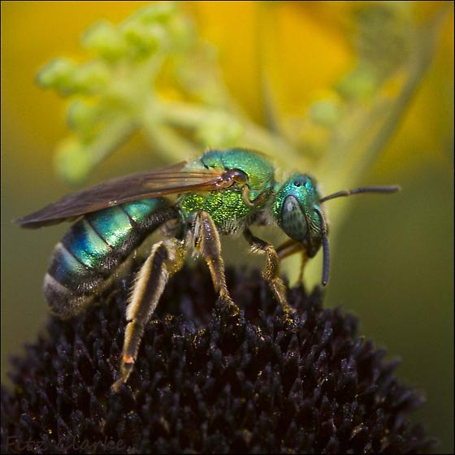
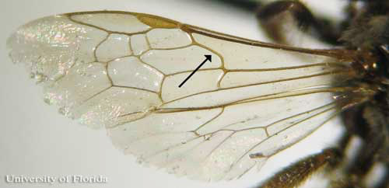
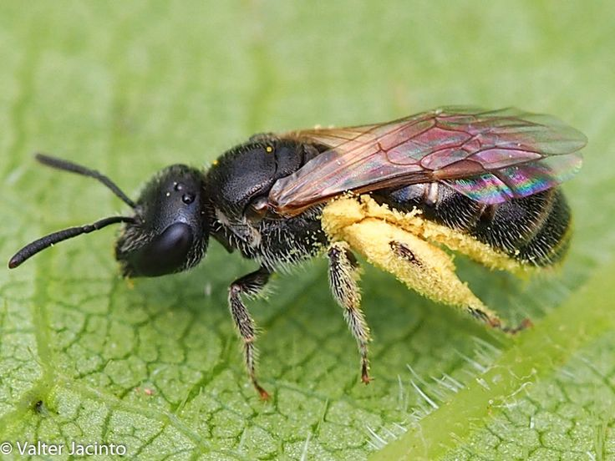

Slide 16
Recap

Slide 17
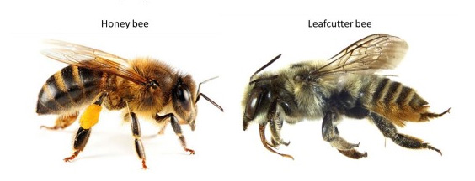

Slide 18
Notes:
Hymenopterans are the bees, wasps, ants and sawflies
14 common hymenopteran families in kenya which can be categorized into four groups: wasps, bees, sawflies and ants
narrow waist present in bees, wasps and ants (apocrita) but absent in sawflies (symphyta)
to the naked eyes, Bees are very hairy, while the others are bald
Within the apocrita, the bees are easily distinguishable because of their hairiness
Ants can be differentiated from wasps by their size; ants are usually smaller, and the shape of their antennae (elbow-shaped in ants)

Slide 19
Notes:
They are different from termites, which belong to the order isopteran and can be distinguished from wasps by the presence of petiole
This is formed by a constriction between the second and third segment of the abdomen – remember that the first segment of the abdomen fuses with the thorax to form the mesonotum

Slide 23
Wasps: 9 common families in Kenya
Siricidae | She
Vespidae | Very
Sphecidae | Sophisticatedly
Crabronidae | Carries
Ampulicidae | A
Pompilidae | Purple
Mutillidae | Megaphone
Ichneumonidae | In
Braconidae | Business

