Slide 1
Review
…ptera (wings)

Slide 2
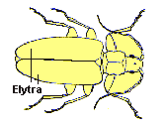
Elytra: hard, sclerotized front wings that serve as protective covers for membranous hind wings

Slide 3
Hemelytra: leathery/parchment-like front wings at base and membranous near tip

Slide 4
Tegmina: front wings that are completely leathery or parchment-like in texture

Slide 5
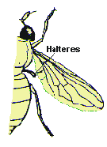
Halteres: small, club-like hind wings that serve as gyroscopic stabilizers during flight

Slide 6
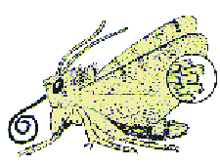
Scaly wings: front and hind wings covered with flattened setae (scales)

Slide 7
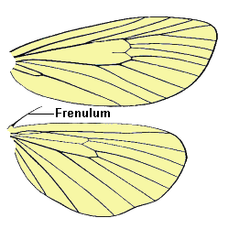
Frenulum: Bristle near base of hind wing that holds front and hind wings together

Slide 8
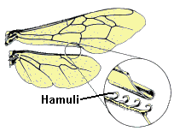
Hamuli: tiny hooks on hind wing that hold front and hind wings together

Slide 9
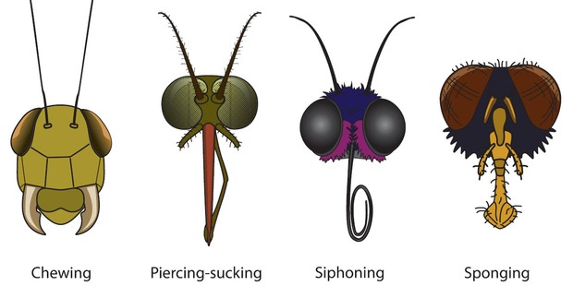
Morphology: insect mouth types
Notes:
Fall into these four broad categories with modifications within each category to suit specific feeding needs

Slide 10
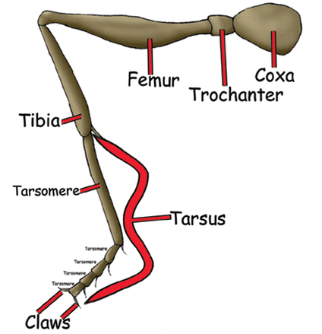
Morphology: insect legs
Notes:
The insect leg is generally divided into five sections….
With the tarsus comprising different numbers of segments depending on taxon, that terminate in claws
Each segment in the tarsus is called a tarsomere

Slide 11
Hymenoptera

Slide 12
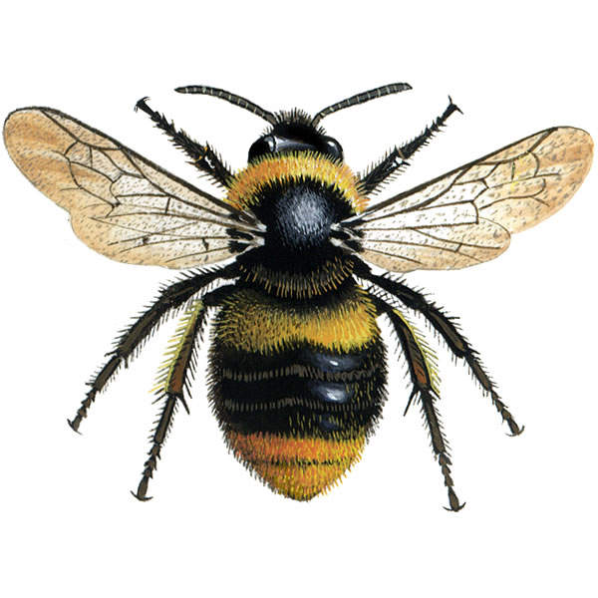
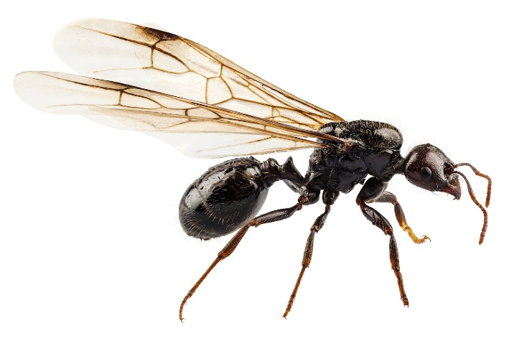
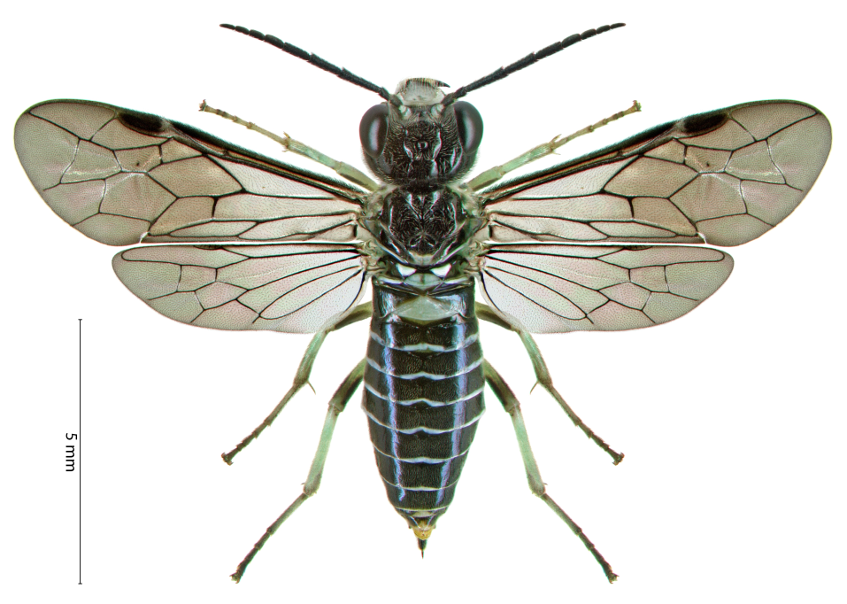
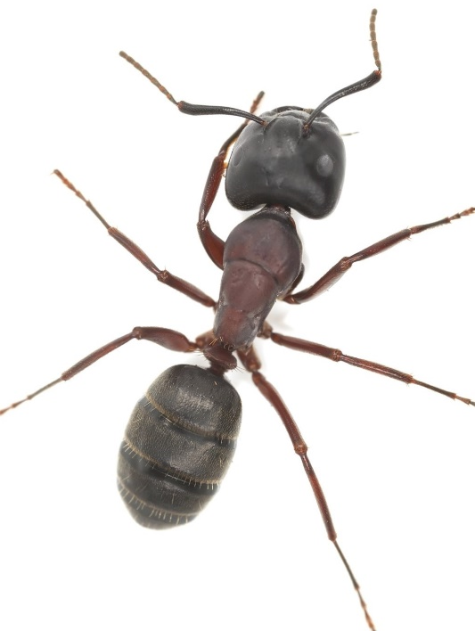
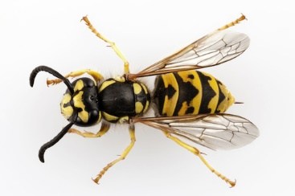
Hymenoptera
bees
sawflies
Junction bw thorax and abdomen:
Symphyta (broad)
Apocrita (narrow)
“hymen” – membrane “ptera” - wings
ants
wasps

Slide 13
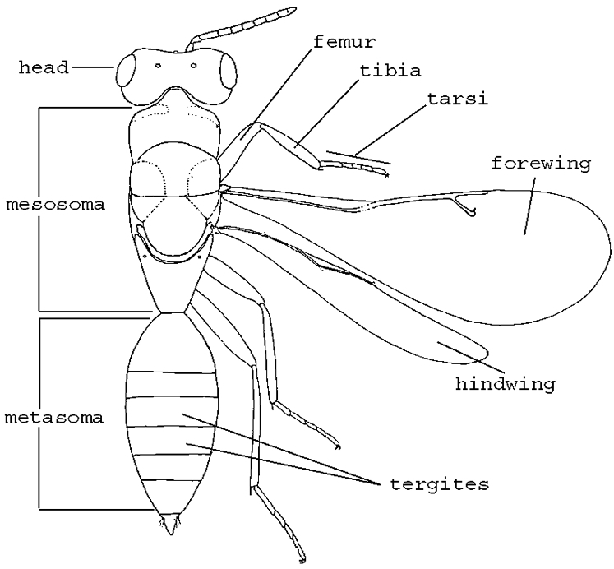
The narrow “waist” in apocrita
(gaster)
Notes:
Recall that insect bodies are divided into 3 sections: the head thorax and abdomen
in apocrita, the narrow waist is formed between the first and second abdominal segments, with the first abdominal segment fused to the thorax to form the mesosoma
The remaining part of the abdomen below the narrow waist is called the metasoma or gaster
Thus, in apocrita the body parts are referred to as the head, mesosoma and metasoma or gaster

Slide 14
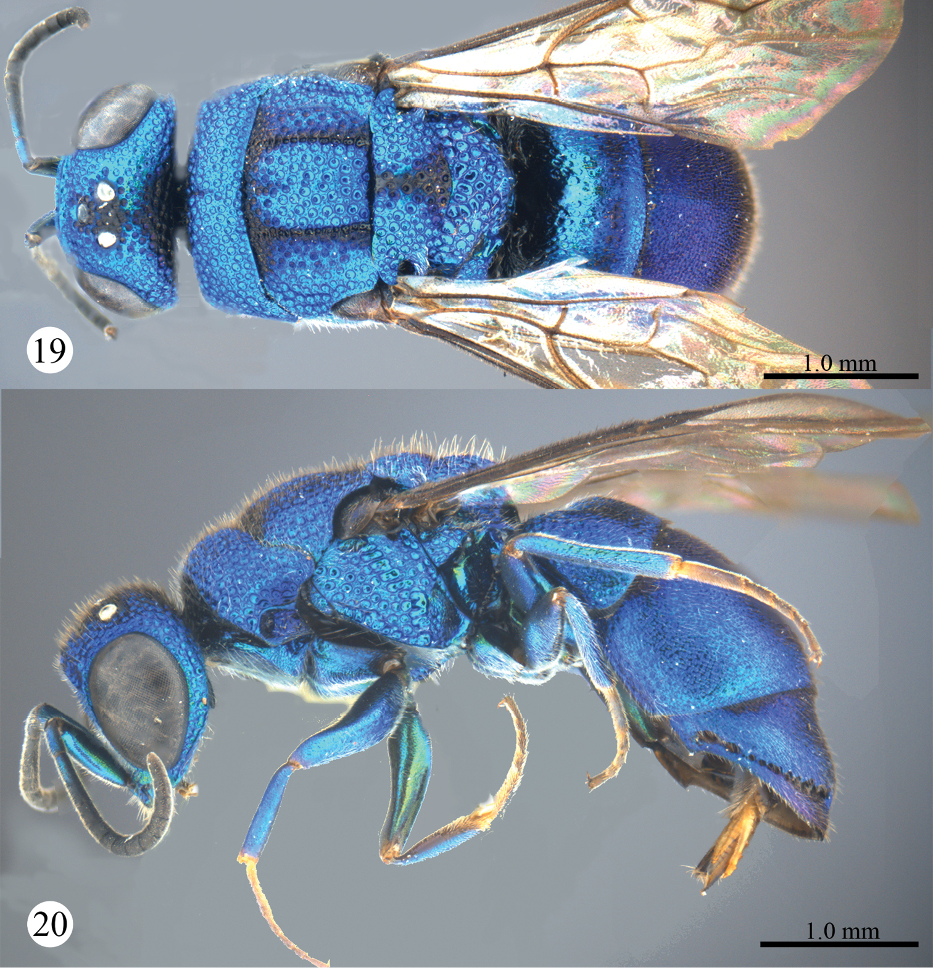
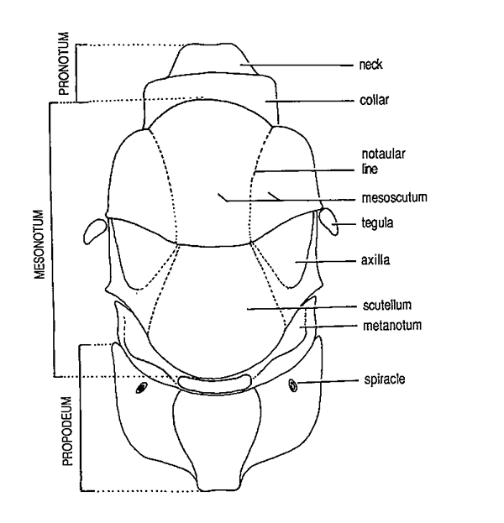
Mesosoma

Slide 15
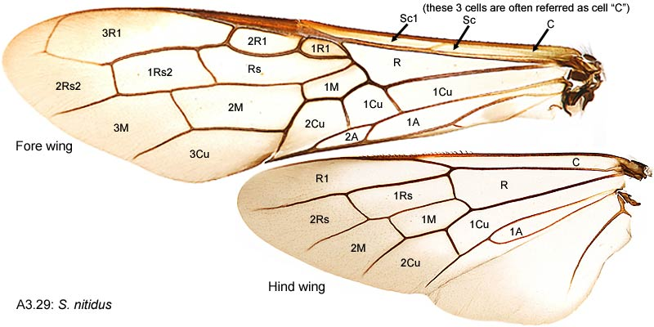
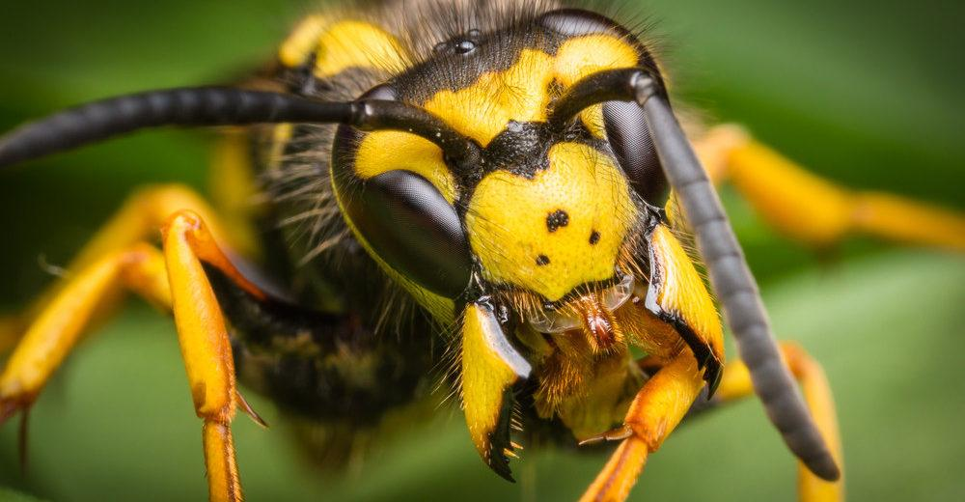
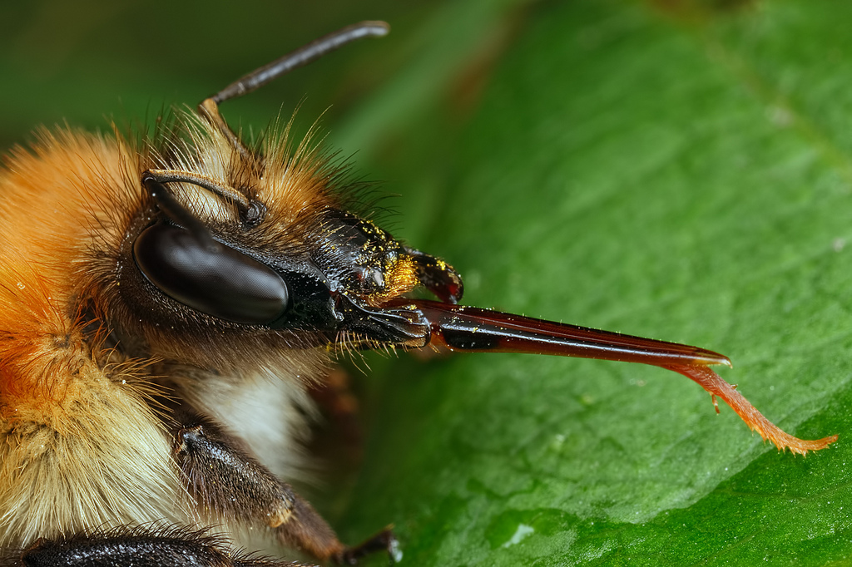
Chewing mouthparts - except in bees (proboscis)
Well developed compound eyes
Triangular stigma in fore wings
Hind wings smaller than front wings, linked together by small hooks (hamuli)
Tarsi usually 5 segments

Slide 16
Classification of Afrotropical hymenoptera
Symphyta | Apocrita
 | Aculeata | Parasitica
4 superfamilies | 3 superfamilies | 12 superfamilies
5 families | 26 families | 41 families
Notes:
Apocrita historically split into two groups: the stingers (aculeata) with ovipositors modified into a stinger
Not all sting though, the ovipositor in non-stingers are modified to serve other purposes or not present at all
The other group comprise all other apocritans except aculeata and is called parasitical as members of this group are mostly parasitic wasps

Slide 17
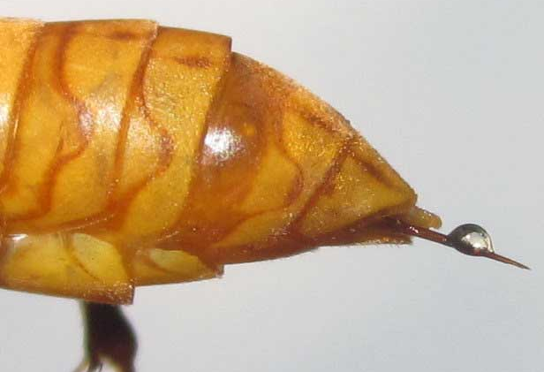
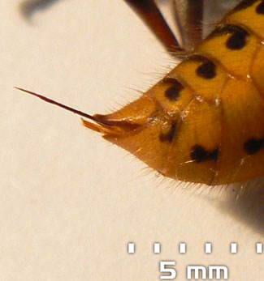
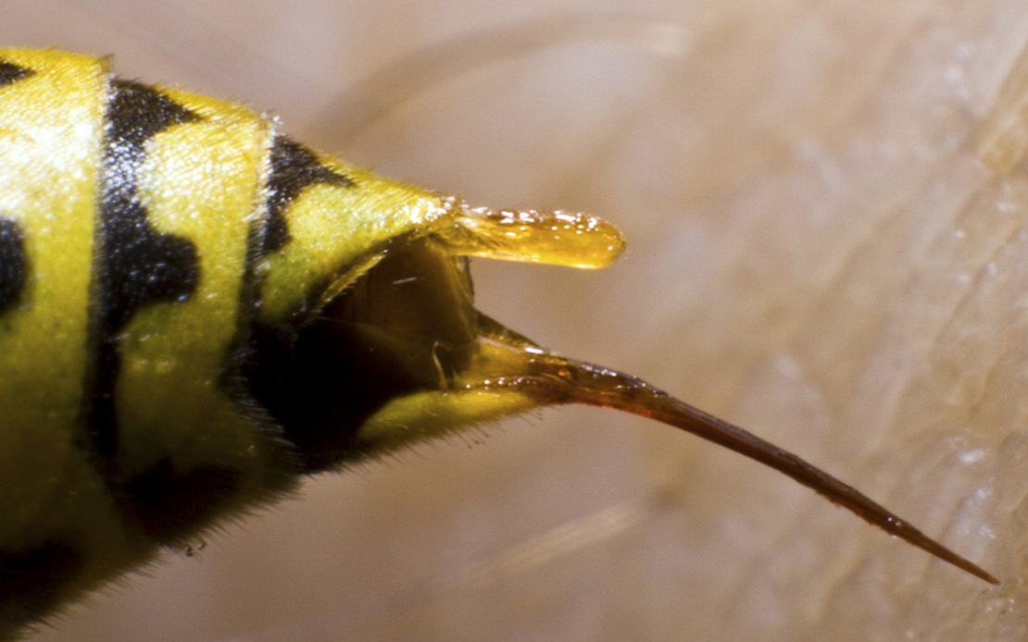
Aculeata: stingers
Not all sting: in these the ovipositors are modified for other purposes or completely absent

Slide 18
Aculeata superfamilies
Apoidea: 10 families
Chrysidoidea: 7 families
Vespoidea: 9 families

Slide 19
Apoidea
Pronotum shortened and collar-like terminating in rounded lobes that do not extend to the tegulae

Slide 20
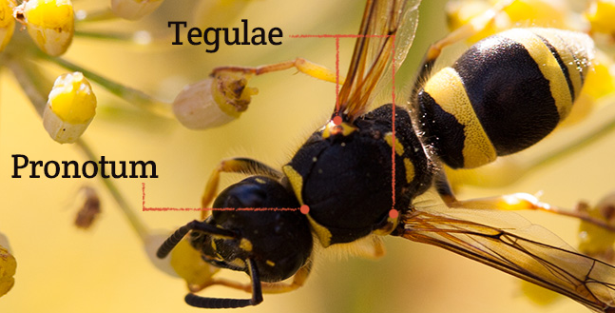

Slide 21
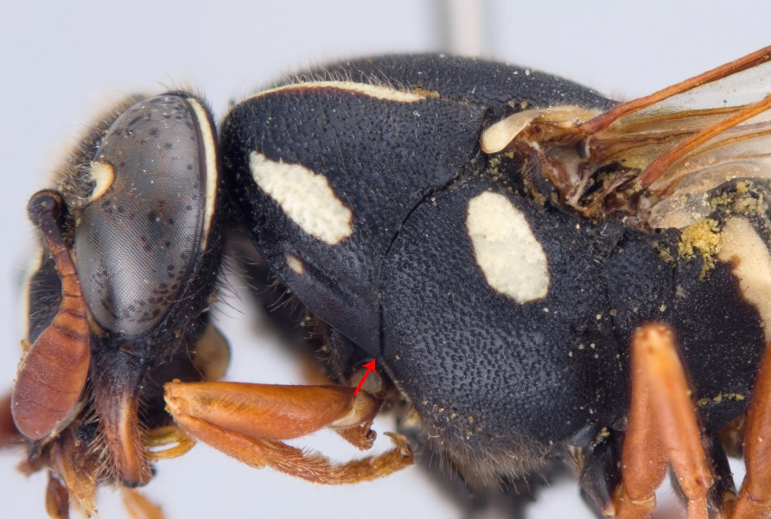
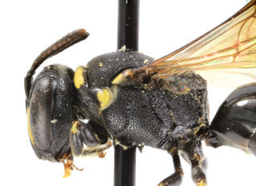
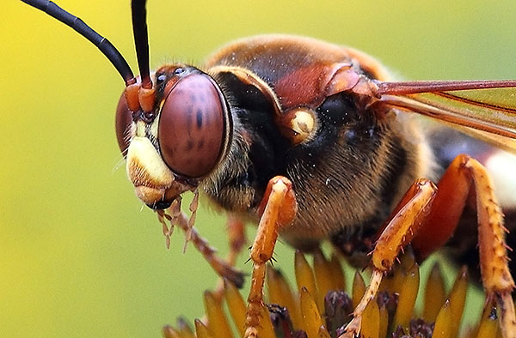
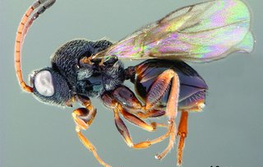
Identify Apoidea
2
1
3
4
5

Slide 22
Subfamily Apoidea: 2 groups
Apiformes (bees)
Spheciformes (sphecoid wasps)

