Slide 1
Non target organisms (NTOs) encountered during use of attractive targeted sugar baits (ATSBs) for mosquito control
Nsa Dada, MSc, PhD
Research Fellow (Entomology)
Division of parasitic diseases and malaria, Center for Global Health
US Centers for Disease Control and Prevention

Slide 2
Goals of this training
Collect & Identify NTOs to family level
Evaluate the effects of ATSBs on NTOs

Slide 3
Overview of ATSBs
“Attract and kill” concept
KEMRI/LSTM ATSB project goal – evaluate the effectiveness of Westham’s next gen mosquito control tool
Notes:
Atsbs work by using the mosquito’s drive for daily sugar meals against itself
Highly attractive combination of juices containing insecticides that attract mosquitoes away from natural sources of sugar. Mortality ensues as soon as insecticides contained in the bait is ingested
Nextgen tool developed based on previously reported successes of the tool and concerns raised about attracting and killing NTOs

Slide 4
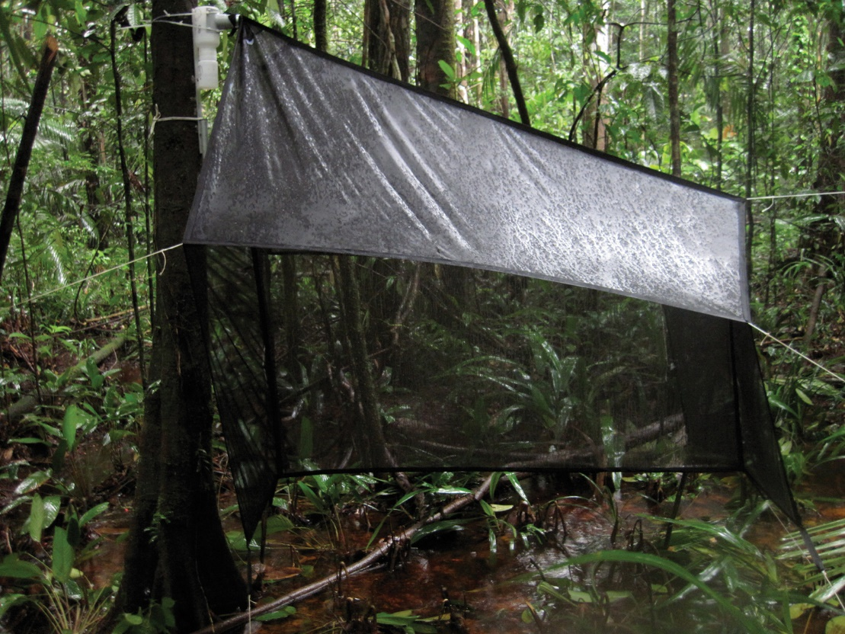
Collection of NTOs: Malaise trap
Tent-like structure
Traps flying insects
Uses insect’s natural flight path

Slide 6
Collection of NTOs: (UV) light trapping

Slide 7
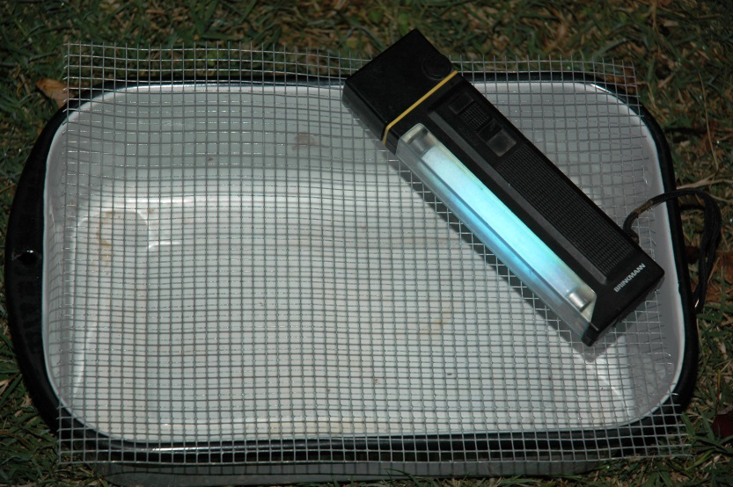
Collection of NTOs: UV-tray traps
Aluminum/enamel/plastic tray
Coated with oil/partially filled w/preservative
Topped with mesh screen
UV lamp
Collects small flying insects e.g. sandflies

Slide 8
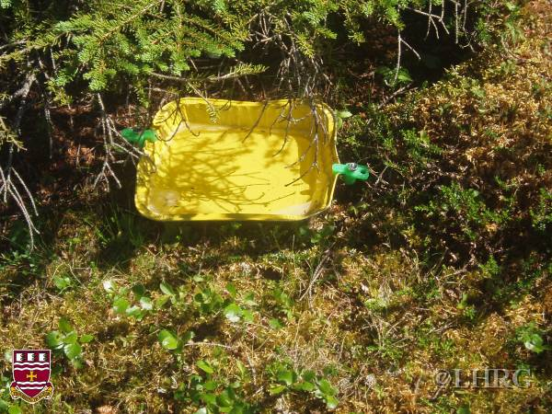
Collection of NTOs: (yellow) pan trap
Just paint/buy!
Plastic/enamel etc
H2O + detergent
Mounted/not
Bees, wasps, thrips, flies, aphids etc

Slide 9
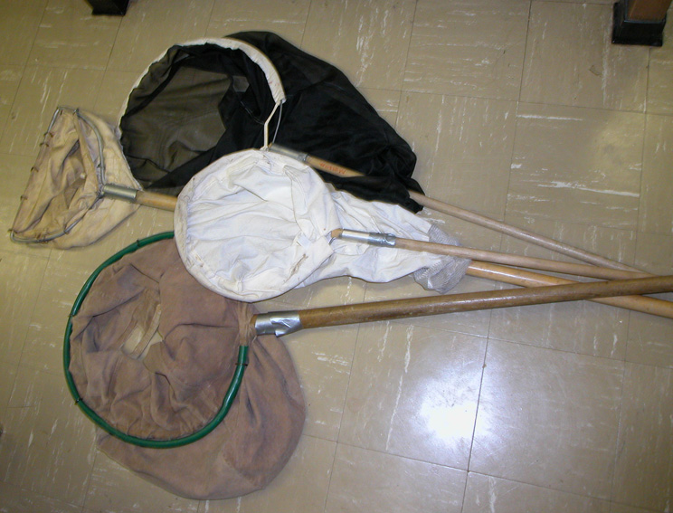
Collection of NTOs: sweep-nets
Our method of choice for the week!

Slide 10
NTOs encountered in previous ATSB studies
Hymenopterans | He
Lepidopterans | Likes
Coleopterans | Cold
Dipterans | Drinks &
Hemipterans | He’s
Orthopterans | Over the moon!

Slide 11
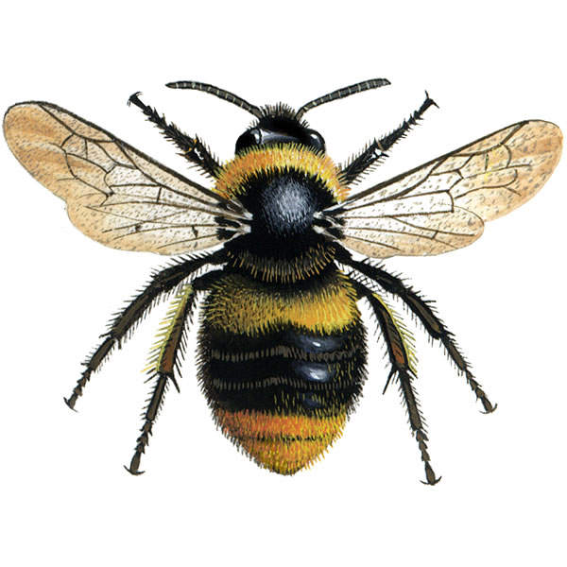
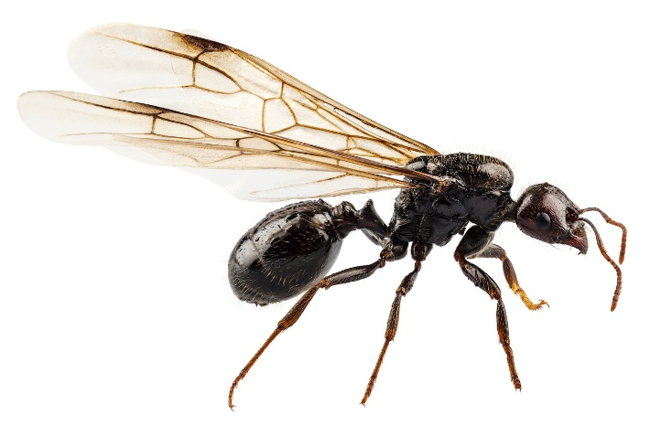
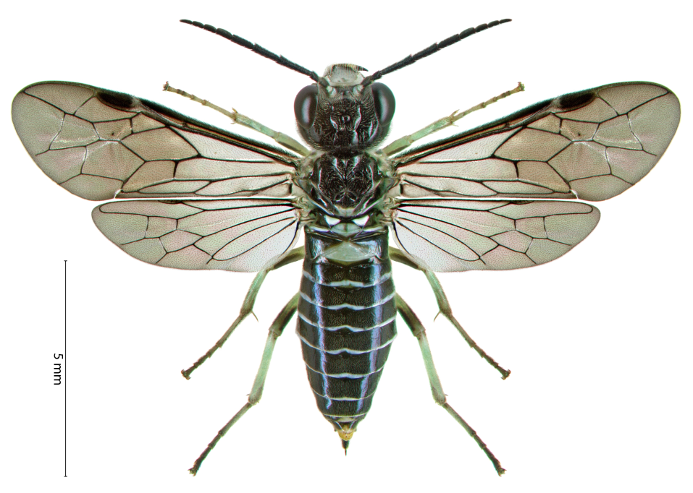
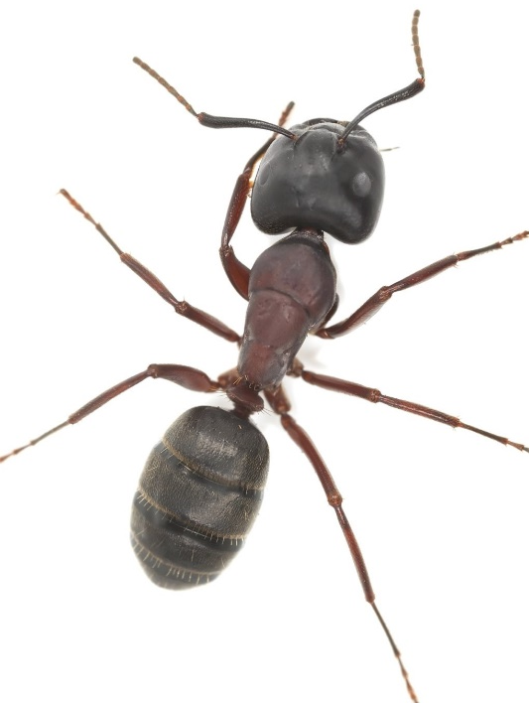
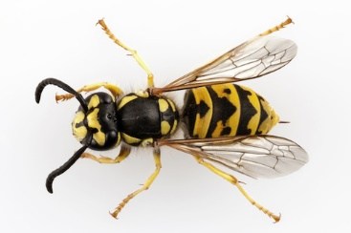
Hymenoptera
bees
sawflies
Junction bw thorax and abdomen:
Symphyta (broad)
Apocrita (narrow)
“hymen” – membrane “ptera” - wings
ants
wasps

Slide 12
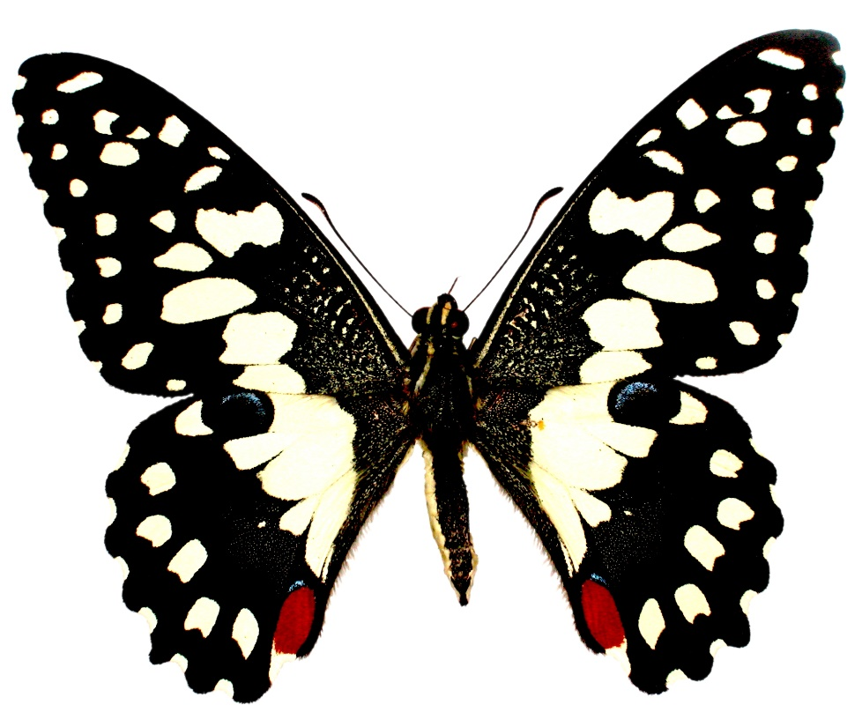
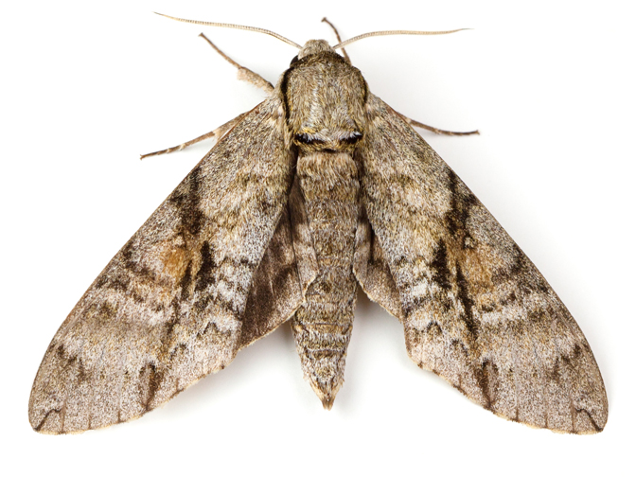
Lepidoptera
butterflies
moths
Antennae:
Knobbed/hooked at tip (butterflies)
Thread-like/comb-like/spindle-shaped (moths)
“lepido” – scale “ptera” - wings

Slide 13
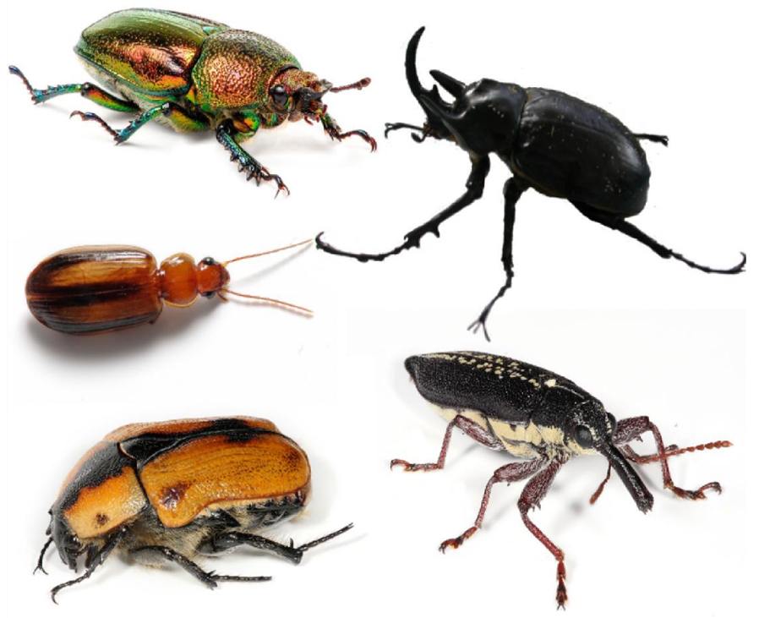
Coleoptera
Modified front wings serve as protective covering for membranous hind wings
“koleos” – sheath “ptera” - wings
beetles

Slide 14
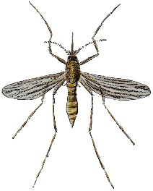
Diptera (true flies)
filiform
stylate
aristate
Antennae:
Nematocera (filiform – thin, segmented)
Brachycera (stylate – final segment terminates in slender point)
Cyclorrhapha (aristate – pouch-like with lateral bristle)
“di” – two “ptera” - wings

Slide 15
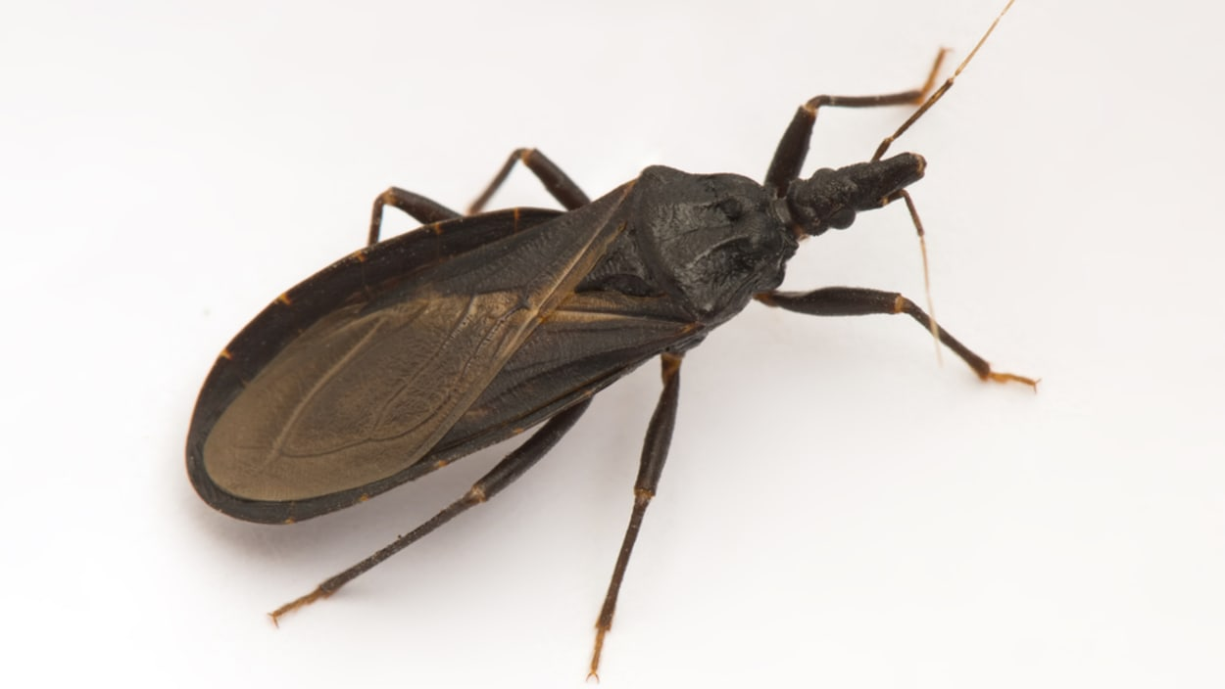
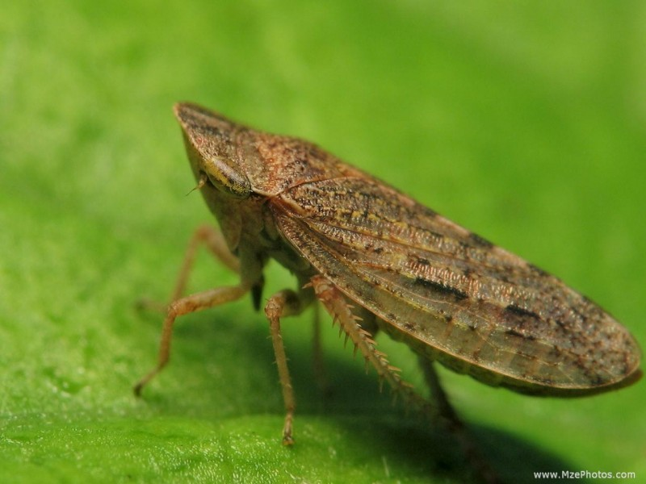
Hemiptera (ambiguous)
triatomines
Wings:
Heteroptera (“hetero” – different); true bugs
Homoptera (“homo” – uniform)
“hemi” – half “ptera” - wings
leafhoppers

Slide 16
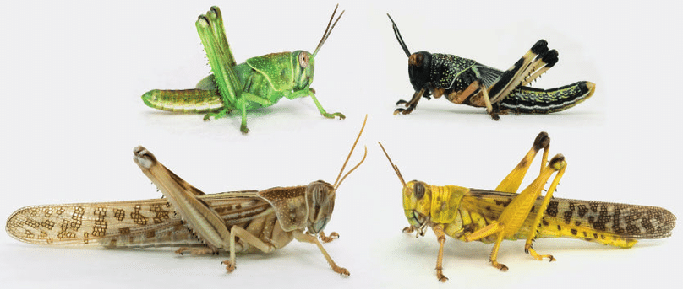
Orthoptera
Locusts, grasshoppers, crickets etc.
Hind legs usually adapted for jumping
“ortho” – straight “ptera” - wings

Slide 17
Review

Slide 18
Membranous wings
bees
sawflies
Symphyta (broad)
Apocrita (narrow)
ants
wasps

Slide 19
Scaled wings
butterflies
moths
Antennae:
Knobbed/hooked at tip
Thread-like/comb-like/spindle-shaped

Slide 20
Sheathed wings
Modified front wings serve as protective covering for membranous hind wings
beetles

Slide 21
Two wings (true flies)
filiform
stylate
aristate
Antennae:
Nematocera (filiform – thin, segmented)
Brachycera (stylate – final segment terminates in slender point)
Cyclorrhapha (aristate – pouch-like with lateral bristle)

Slide 22
Half winged
triatomines
Wings:
Heteroptera (“hetero” – different); true bugs
Homoptera (“homo” – uniform)
leafhoppers

Slide 23
Straight winged
Locusts, grasshoppers, crickets etc.
Hind legs usually adapted for jumping

